Slide 1

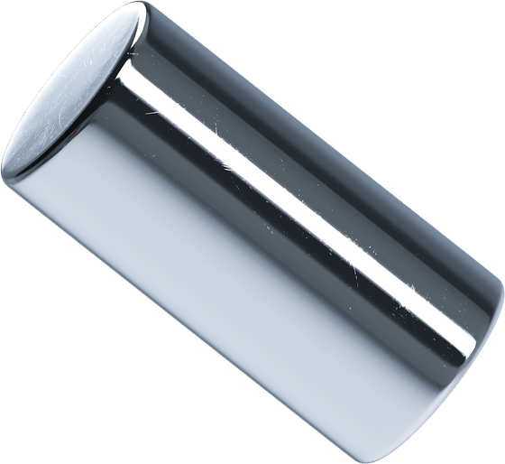

GROUP 8
MOVIE RECOMMENDATION SYSTEM

Slide 2
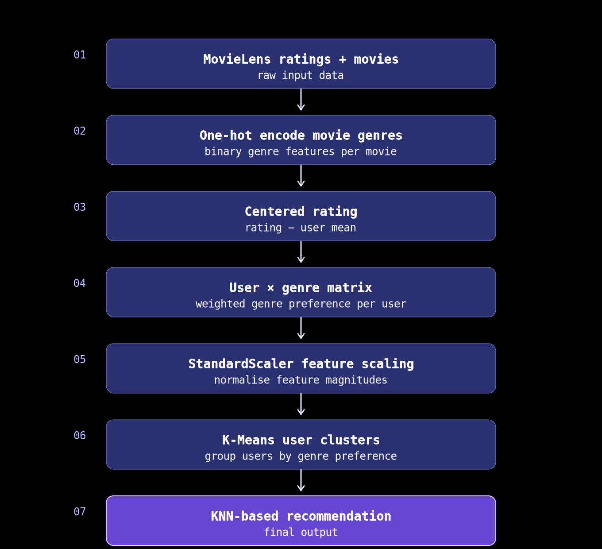
METHODOLOGY PIPELINE
EDA
ratings · user activity · genres
↓
• MovieLens: 100,836 ratings from 610 users and 9,742 movies.
Feature engineering
one-hot genre flags + rating join
↓
• EDA describes rating values, user activity and the genre mix.
Centered User–Genre
610 users × 19 preference features
↓
Scaling
• Centered User–Genre features capture taste relative to each user’s mean.
StandardScaler by genre
↓
K-Means
• The report selects K = 5; recommendations use users in the same cluster.
train candidate user clusters
↓
K Selection
Choose K = 5
↓
Recommendation
same-cluster weighted ranking
Notes:
Presentation order requested by the group. Report §4 supplies the three EDA figures. The report selects K=5 with random_state=42 and n_init=10. The supplied recommender.ipynb still sets K_OPTIMAL=6 and implements a different KNN/vote-ranking recommendation method.

Slide 3
EDA: DATA OVERVIEW
100,836
RATINGS
610 users · 9,742 movies
0
MISSING VALUES
movies.csv and ratings.csv
0
UNMATCHED MOVIE IDS
every rating joins to a movie
34
MOVIES WITHOUT A GENRE LABEL
excluded from the 19 genre features
No duplicate (userId, movieId) pairs were found.
Notes:
Source: movies.csv and ratings.csv, independently checked; 100,836 rating events, 610 users, 9,742 movies, zero missing entries, zero unmatched IDs and zero duplicate user/movie pairs. The 34 movies marked (no genres listed) remain in the source but are not a genre feature.

Slide 4
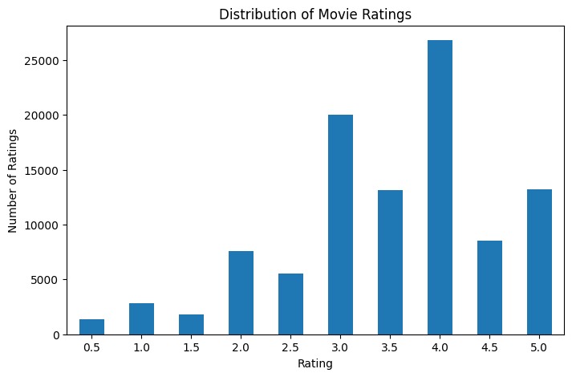
EDA: RATING DISTRIBUTION
MAIN OBSERVATION
Most ratings are 3.0 stars or higher, with 4.0 the most frequent. Very low ratings are uncommon.
Notes:
Source image extracted without redrawing from report (2)(1).pdf, PDF page 9, Figure 3. The 0.5-star categories are read directly from the original chart.

Slide 5
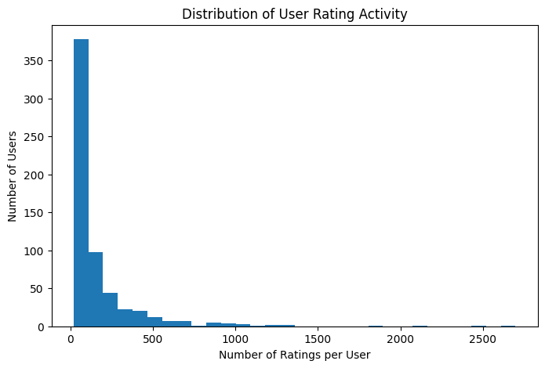
EDA: USER ACTIVITY
MAIN OBSERVATION
Most users rate relatively few movies, while a small number contribute over 1,000 ratings. User activity is highly uneven.
Notes:
Source image extracted without redrawing from report (2)(1).pdf, PDF page 10, Figure 4. The plotted x-axis is Number of Ratings per User and y-axis is Number of Users. Report §4.2 incorrectly describes it as a distribution of per-user mean ratings; no claim about mean rating is inferred from this figure.

Slide 6
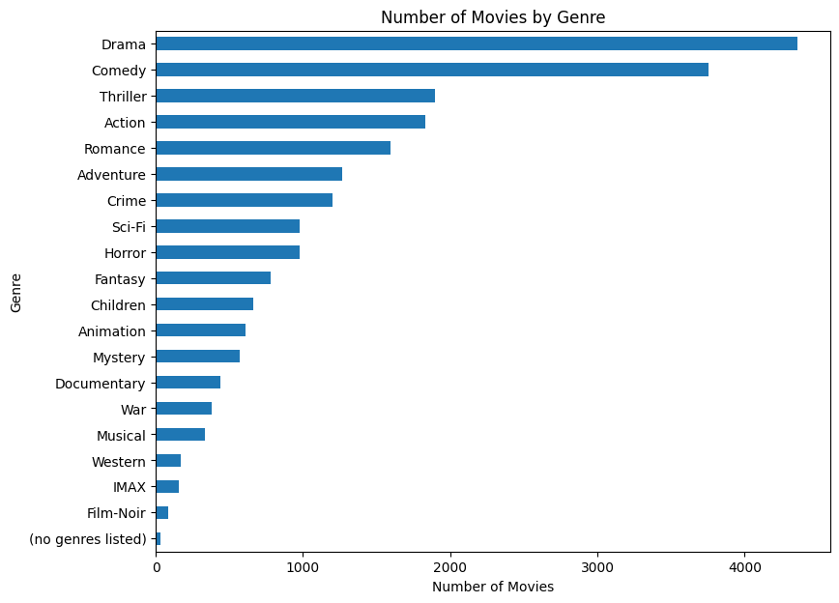
EDA: GENRE DISTRIBUTION
MAIN OBSERVATION
Drama and Comedy dominate the catalog, while genres such as Film-Noir and IMAX have far fewer movies. This imbalance may favor common genres in the model.
Notes:
Source image extracted without redrawing from report (2)(1).pdf, PDF page 11, Figure 5. Each movie with several genres contributes to multiple category counts.

Slide 7
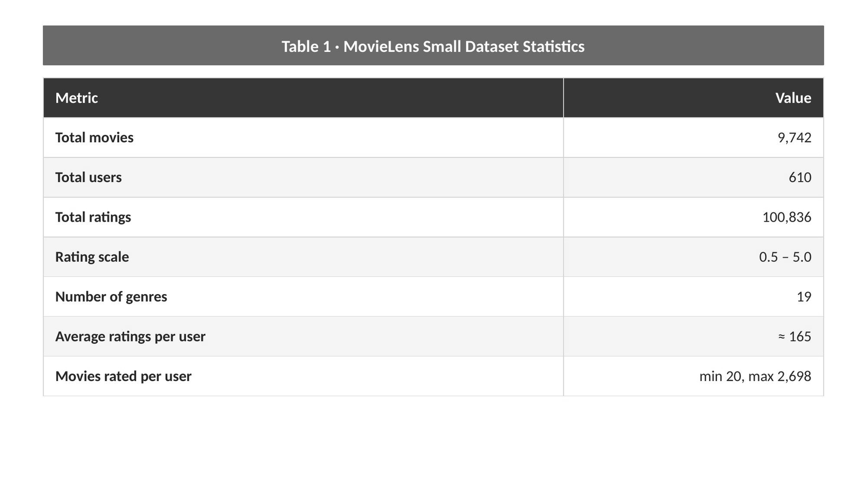
DATA PREPROCESSING
  The system uses two main CSV files from the MovieLens small dataset: movies.csv and ratings.csv
  The movie file contains 9,742 movies with three main columns: movieId, title, and genres
  The rating file contains 100,836 ratings from 610 users on a scale from 0.5 to 5.0

Slide 8
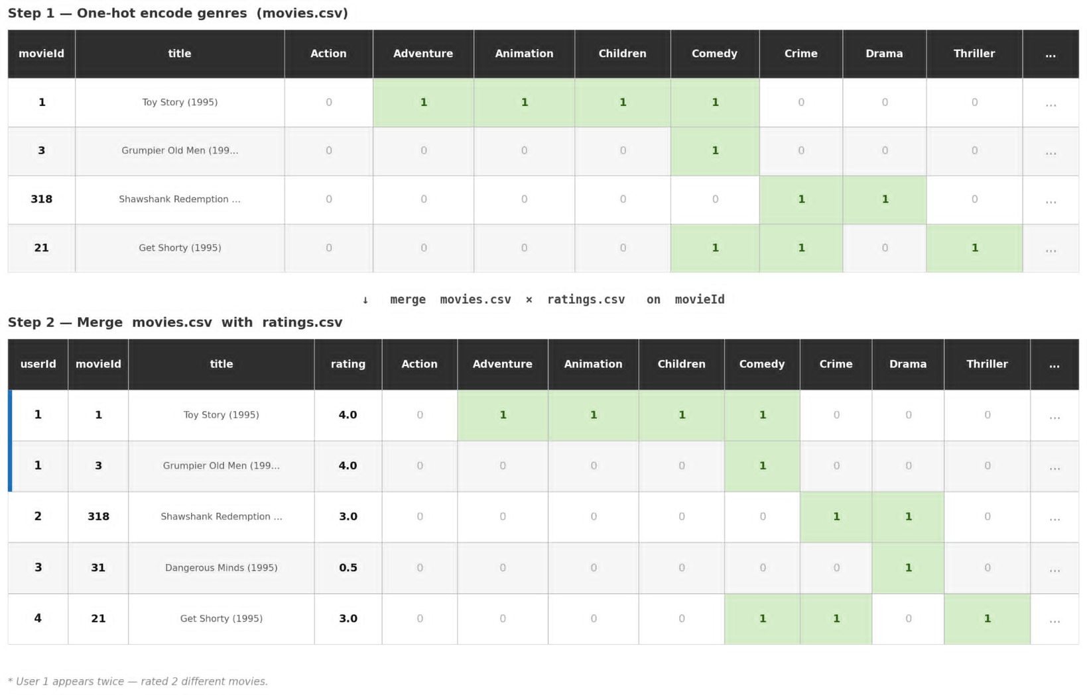
Data Preprocessing
  Each genre becomes a binary column, converting categorical text into numeric values ready for further processing.
  This merged table serves as the foundation for computing each user's genre preference in the next step.

Slide 9
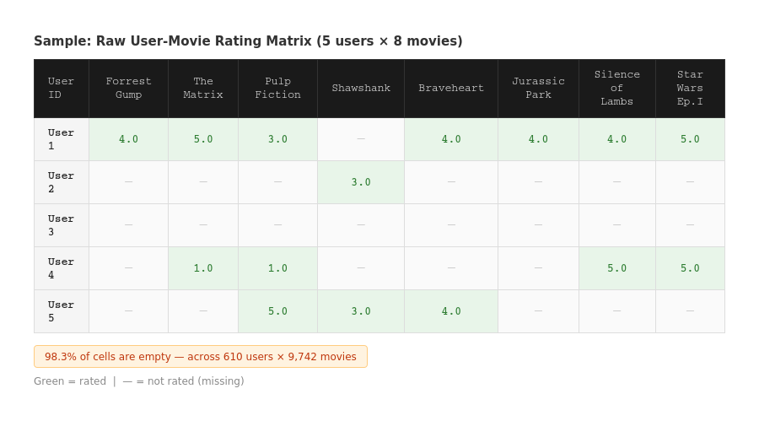
CENTERED RATING
610 USERS × 9,742 MOVIES — BUT MOST CELLS ARE NEVER FILLED

Slide 10
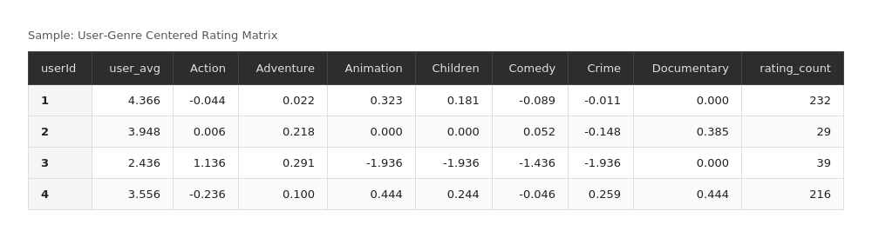
CENTERED RATING
Each value = user's avg rating on that genre − their overall avg rating
  Positive → user likes that genre more than average
  Negative → user likes it less than average
  Centered rating removes personal bias → scores reflect true genre preference, not rating habits

Slide 11
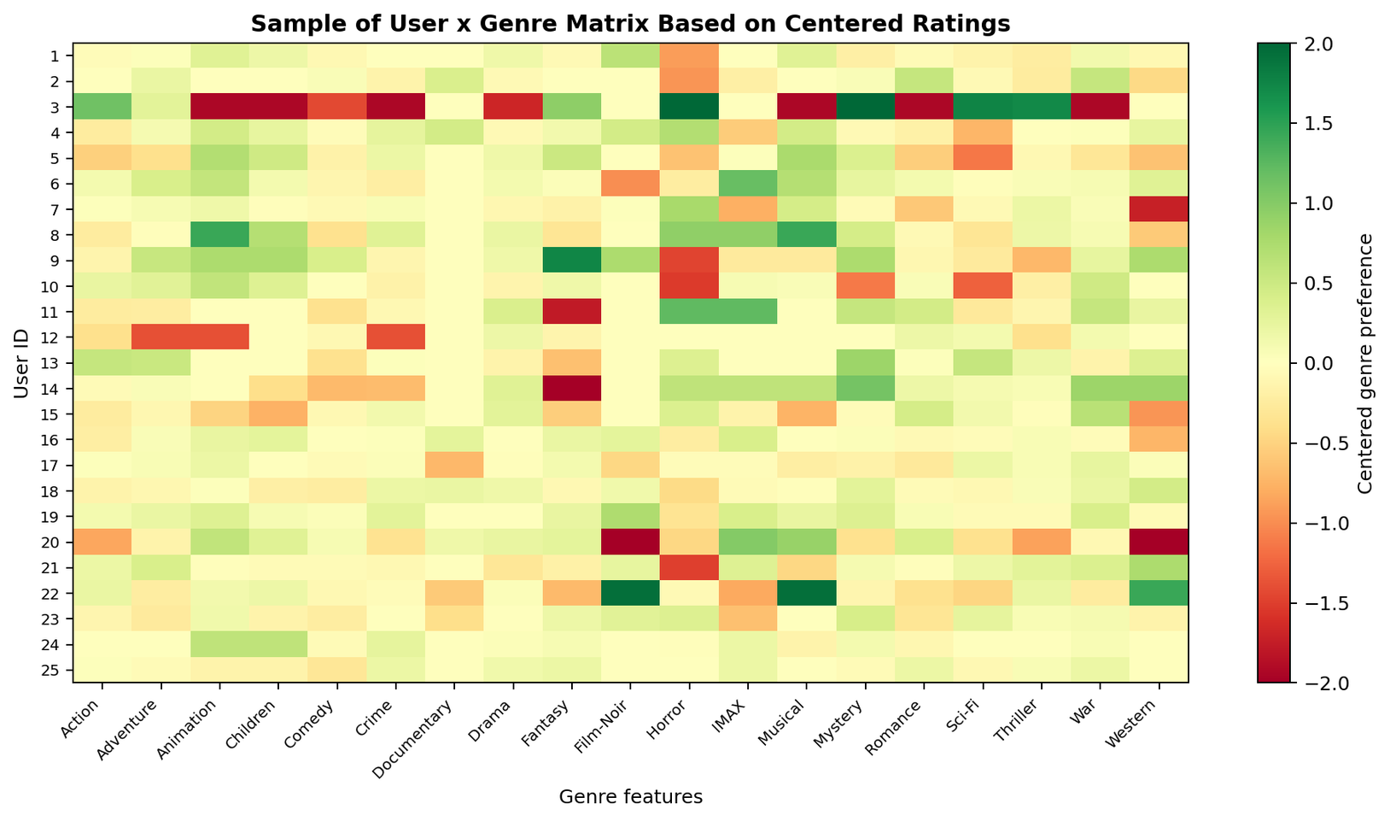

USER-GENRE MATRIX
  610 × 19 user–genre matrix.
  14.43% zero entries (neutral fill or exact zero); 98.3% of user–movie cells are unobserved.
  All 610 users retained (at least 20 ratings each).

Slide 12
FEATURE SCALING
STANDARDIZATION
z = (R - mean) / std
R: centered genre preference mean/std: computed per genre column
WHY
K-Means uses Euclidean distance; high-variance genres can dominate the distance calculation.
WHY
HOW
Apply StandardScaler to every genre column of the User-Genre matrix.
HOW
EFFECT ON SELECTED GENRES
Genre | Before mean | Before std | After mean | After std
Action | -0.102 | 0.345 | 0.000 | 1.000
Animation | -0.004 | 0.600 | 0.000 | 1.000
Documentary | 0.062 | 0.431 | 0.000 | 1.000
OUTCOME
Each genre feature has mean about 0 and standard deviation about 1 after scaling.
OUTCOME
RAW USER-GENRE MATRIX
⟶
STANDARDSCALER
⟶
SCALED MATRIX Z
⟶
K-MEANS

Slide 13
K-MEANS CLUSTERING
01
CHOOSE K CENTROIDS
For each candidate K, fit K-Means to the scaled user vectors.
02
ASSIGN USERS
Place each user with the nearest centroid by Euclidean distance.
03
UPDATE CENTROIDS
Use the mean of the members in each cluster; repeat until stable.
SELECTION RUN: K = 2–14 · random_state = 42 · n_init = 10
Notes:
Source: report §3.5 and §5.2. K-Means is fitted on StandardScaler output from the 610×19 centered User–Genre matrix. Candidate values K=2 through K=14 use random_state=42 and n_init=10.

Slide 14
K SELECTION: K = 5
MEAN SILHOUETTE ACROSS TESTED SEEDS
K = 5
SSE 9,430.9
Mean Silhouette 0.0429
Worst min. cluster 18
K = 5 balances separation with usable cluster sizes. SSE alone has no sharp elbow.
Notes:
Source: report PDF pages 12–13, Tables 8 and 9. K=5 mean Silhouette 0.0429 (SD 0.0139) across report-tested seeds; K=6 0.0264, K=7 0.0288, K=8 0.0262. Report SSE for K=5 = 9430.9; no single sharp elbow. Worst min cluster across tested seeds = 18 for K=5. K=5 is a practical trade-off, not a universal metric optimum. Supplied notebook still hard-codes K_OPTIMAL=6.

Slide 15
FIVE USER CLUSTERS
USERS PER CLUSTER
CENTROID GENRE SIGNATURES
C0 107 USERS
Crime · Film-Noir · Drama
Lower: Sci-Fi, IMAX
C1 279 USERS
War · Animation · IMAX
Lower: Horror, Action
C2 63 USERS
Fantasy · Animation · Children
Lower: Thriller, Mystery
C3 25 USERS
War · Drama · Mystery
Lower: Animation, Children
C4 136 USERS
Mystery · Thriller · IMAX
Lower: Children, Musical
Genre preferences are centered on each user’s own average rating.
Notes:
Source: report PDF page 8 Table 6, page 13 discussion, and independent rerun on supplied CSV using StandardScaler and KMeans(n_clusters=5,random_state=42,n_init=10). Cluster labels 0–4 and sizes 107,279,63,25,136 match the report exactly. Displayed top three and bottom two genres are means of centered features by cluster, independently recomputed.

Slide 16
K = 5: MODEL EVALUATION
0.0638
2.6753
25
SILHOUETTE
DAVIES–BOULDIN
SMALLEST CLUSTER
Single run; weak separation
Single run; lower is better
All five clusters have users
STABILITY ACROSS TESTED SEEDS
Report: mean Silhouette 0.0429 ± 0.0139; worst minimum cluster size 18.
Taste groups overlap, so cluster membership is an approximate segmentation.
Notes:
Source: independent K=5 recomputation on supplied CSV confirms single-run Silhouette 0.063847, Davies–Bouldin 2.675324, smallest cluster 25. Multi-seed means and SD are from report PDF page 13 Table 9, with seed list not specified there. The low Silhouette values limit the strength of separation claims.

Slide 17
CLUSTER-BASED RECOMMENDATION
01
Assign the target user to one of five clusters
02
Collect movies rated by other users in the same cluster
03
Remove movies already watched by the target user
04
Keep candidates with at least three cluster ratings
05
Rank by mean rating × ln(1 + rating count)
06
Return the highest-scoring unseen movies
score(movie) = average rating × ln(1 + number of cluster ratings)
Notes:
Source: report PDF pages 8–9, §3.6. This is the report’s cluster-based weighted-ranking procedure (tau=3), not the supplied recommender.ipynb implementation. The notebook currently uses K=6, cosine KNN within cluster, min_votes=2 and vote ranking. Revise notebook before presenting this report procedure as implemented code.

Slide 18
RECOMMENDATION EXAMPLE
TOP 5 UNWATCHED MOVIES
MOVIE | AVG RATING | COUNT | SCORE
The Usual Suspects (1995) | 4.239 | 46 | 16.321
Schindler’s List (1993) | 4.070 | 50 | 16.003
American Beauty (1999) | 4.154 | 39 | 15.323
One Flew Over the Cuckoo’s Nest (1975) | 4.288 | 33 | 15.121
Seven (1995) | 4.066 | 38 | 14.895
The list is based on 106 other users in User 50’s K = 5 cluster.
Notes:
Source: report PDF page 14 Table 10. Independently reproduced from supplied CSV: User 50 has 310 ratings, mean 2.780645 and K=5 cluster 0. Exclude user 50 and watched movies; require at least 3 other cluster ratings; score = avg_rating × log(1+count). Movie IDs 50,527,2858,1193,47 yield reported order and scores. These results do not come from the supplied recommender.ipynb KNN demo.

Slide 19
RECOMMENDATION EXAMPLE
USER 50
Cluster 0 of 5
User 50 has rated 310 movies.
Candidate movies come from 106 other users in Cluster 0.
TOP 5 MOVIES RECOMMENDED TO USER 50
MOVIE | AVG. RATING | COUNT | SCORE
The Usual Suspects (1995) | 4.239 | 46 | 16.321
Schindler’s List (1993) | 4.070 | 50 | 16.003
American Beauty (1999) | 4.154 | 39 | 15.323
One Flew Over the Cuckoo’s Nest (1975) | 4.288 | 33 | 15.121
Seven (1995) | 4.066 | 38 | 14.895
All five movies are unseen by User 50. Ratings and counts come from other users in Cluster 0.
Score = average rating × ln(1 + rating count).
Notes:
Source: report PDF §5.4, Table 10, and independent K=5 recomputation on the supplied MovieLens CSV. User 50 has 310 prior ratings and belongs to cluster 0 (107 users total). The other 106 users provide candidate ratings. Exclude movies rated by User 50, require at least three cluster ratings, then rank by average rating × ln(1+rating count). The five displayed titles and numeric values match the report. They are recommendations; the dataset does not establish that User 50 has watched or liked these five movies.

Slide 20
REFERENCES
  HARPER, F. M., & KONSTAN, J. A. (2015). THE MOVIELENS DATASETS: HISTORY AND CONTEXT. ACM TRANSACTIONS ON INTERACTIVE INTELLIGENT SYSTEMS, 5 (4), ARTICLE 19. HTTPS://DOI.ORG/10.1145/2827872
  LEE, J. H., KIM, D. H., LEE, Y. H., & HWANG, I. (2012). A LITERATURE REVIEW AND CLASSIFICATION OF RECOMMENDER SYSTEMS RESEARCH. EXPERT SYSTEMS WITH APPLICATIONS, 39 (11), 10059–10072. HTTPS: //DOI.ORG/10.1016/J.ESWA.2012.02.038

Slide 21


